Slide 1




BUS
TICKET BOOKING
&
TRACKING
ANSH PATEL PRAGNESHKUMAR
ROLL : 12 BRANCH : CE
ENROLMENT NO : 22002170110104
BATCH : D1

Slide 2

CONTENT
01
INTRODUCTION
02
FUNCTIONALITIES
03
MERITS
04
DEMERITS
05
FUTURE SCOPE

Slide 3
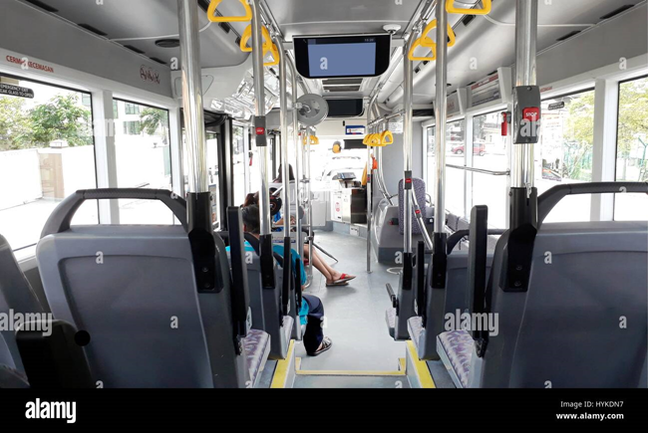
INTRODUCTION
The Bus Ticket Booking and Tracking System is an essential component of modern public transportation services. It simplifies the process of booking bus tickets for passengers and enables them to track the real-time location and status of buses during their journey. This system leverages technology to enhance the overall travel experience, providing convenience, efficiency, and improved management for both passengers and transport authorities.

Slide 4





FUNCTIONALITIES
OBJECTIVE 2
OBJECTIVE 4
Book complete bus and get shortest path using graph data structure.
Book, Cancel And View Your Tickets all at one place.
OBJECTIVE 1
OBJECTIVE 3
Register - To create new account.
Login - To access your existing account.
Admin interface that can access add, remove and modify routes and schedules.

Slide 5
MERITS
User friendly interface.
Dynamic and expandable.
SQL queries are parameterized, reducing the risk of SQL injection.
Proper exception handling is in place to manage unexpected input.
The code includes validation checks to ensure data integrity.

Slide 6
DEMERITS
It uses command line interface which is slow and inconvenient.
It is not thread safe.
Program is designed to handle most of the possible exceptions but there might still be some overlooked exceptions.
Code Duplication might be an issue.

Slide 7


FUTURE
SCOPE
Mobile Ticketing and Digital Wallets.
Real-Time GPS Tracking.
Handling Concurrent transactions and bookings.
Privacy and Security Improvements.
Additional Services.

Slide 8


THANK
YOU

